Slide 1
File Encryptor using various Encryption Algorithms for remote upload in cloud
- a capstone presentation

Slide 2
Introduction
Importance of Securing Data in Cloud Storage:
Rapid Growth: Cloud storage usage has surged due to its convenience and scalability.
Data Sensitivity: Many users store sensitive and confidential information in the cloud.
Common Risks:
Unauthorized Access: Potential for hackers to gain access to unencrypted data.
Data Breaches: Increasing incidents of data breaches targeting cloud storage services.
Data Integrity Issues: Risk of data being altered or tampered with during transfer and storage.
Need for Enhanced Security:
Ensuring data privacy and protection.
Complying with regulations and standards.
Providing peace of mind for users transferring and storing data in the cloud.

Slide 3

Key Concepts
Encryption: The process of converting plaintext into ciphertext using an algorithm and a key.
Decryption: The process of converting ciphertext back into plaintext using the corresponding key.
Symmetric Key: A single key used for both encryption and decryption (e.g., AES, Blowfish).
Asymmetric Key: A pair of keys where one is used for encryption (public key) and the other for decryption (private key) (e.g., RSA).
Importance of Cryptography:
Data Security: Protects sensitive information from unauthorized access and breaches.
Data Integrity: Ensures that data has not been altered or tampered with.
Authentication: Verifies the identity of users and the authenticity of messages.
Non-repudiation: Prevents entities from denying their actions, ensuring accountability.
Challenges in Cryptography:
Key Management: Securely managing and distributing cryptographic keys.
Performance: Balancing security and performance, especially for large data sets.
Evolving Threats: Constantly adapting to new and sophisticated attacks.

Slide 4
AES (Advanced Encryption Standard)
Overview:
Symmetric Encryption: Uses the same key for both encryption and decryption.
Advantages:
High Security: Resistant to all known attacks.
Efficiency: Fast encryption and decryption processes.
Versatility: Used in a wide range of applications from file encryption to securing communications.
Key Features:
Confidentiality: Ensures that data is unreadable to unauthorized users.
Integrity: Protects against data tampering.
Authentication: Verifies the identity of the data sender.
Key Sizes: Supports 128, 192, and 256-bit keys.
Block Cipher: Encrypts data in fixed-size blocks (128 bits).

Slide 5
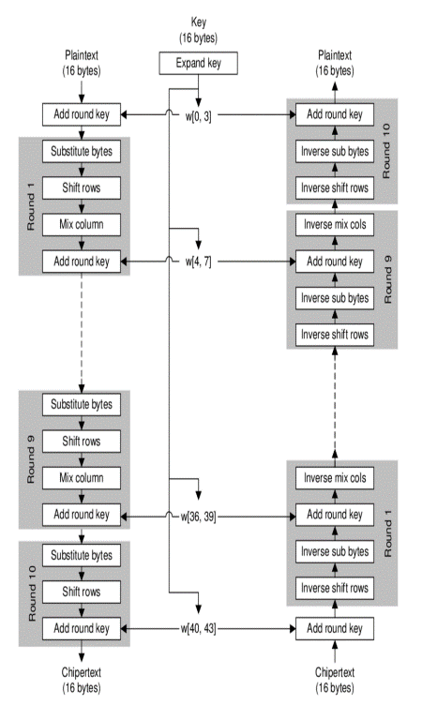
ENCRYPTION ALGORITHM WORKFLOW:
DECRYPTION ALGORITHM WORKFLOW:

Slide 6
RSA (Rivest-Shamir-Adleman)
Overview:
Asymmetric Encryption: Uses a pair of keys – a public key for encryption and a private key for decryption.
Inventors: Developed by Ron Rivest, Adi Shamir, and Leonard Adleman in 1977.
Key Sizes: Commonly 1024, 2048, or 4096 bits for enhanced security.
Advantages:
High Security: Difficult to crack due to the complexity of factoring large prime numbers.
Public Key Infrastructure (PKI): Supports digital signatures and certificates.
Non-repudiation: Ensures that a sender cannot deny sending a message.
Key Features:
Public and Private Keys: Encryption with the public key and decryption with the private key.
Authentication: Confirms the identity of the sender.
Data Integrity: Ensures that the message has not been altered.

Slide 7
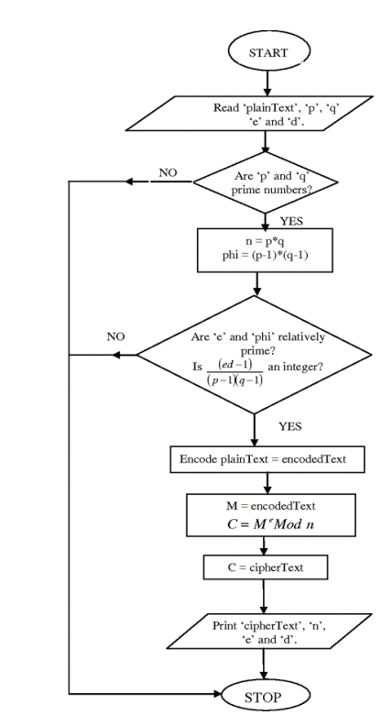
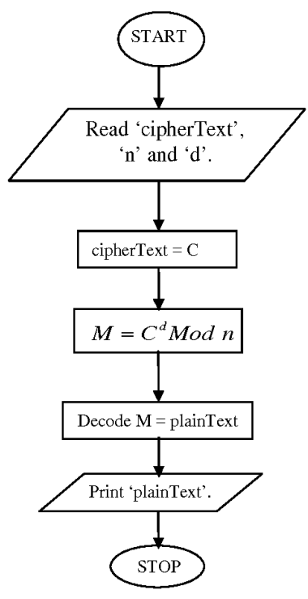
ENCRYPTION ALGORITHM WORKFLOW:
DECRYPTION ALGORITHM WORKFLOW:

Slide 8
Blowfish
Overview:
Symmetric Encryption: Uses the same key for both encryption and decryption.
Block Cipher: Encrypts data in 64-bit blocks.
Key Size: Variable key length ranging from 32 to 448 bits.
Advantages:
Speed: Known for its fast encryption and decryption speeds.
Flexibility: Allows users to select key lengths, balancing security and performance.
Security: Resistant to known attacks; considered very secure when using longer key lengths.
Key Features:
Variable Key Length: Users can choose key sizes to meet specific security needs.
Compactness: Efficient in terms of memory usage and performance.
Widely Available: Freely available and unpatented, making it accessible for various applications.

Slide 9
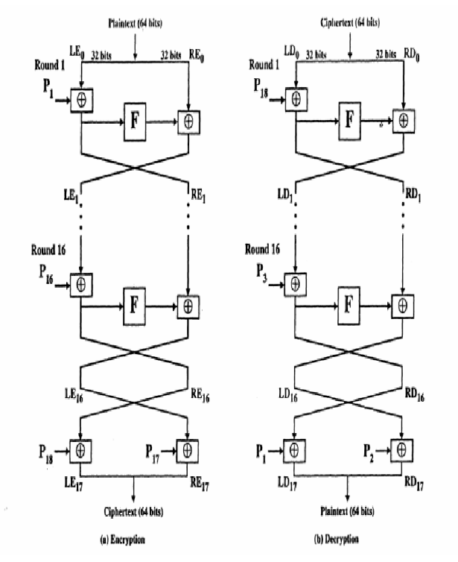
ENCRYPTION ALGORITHM WORKFLOW:
DECRYPTION ALGORITHM WORKFLOW:

Slide 10

Why Use File Encryptor?
Enhanced Security:
Protect Sensitive Data: Ensures that sensitive information is secure during transfer and storage.
Prevent Unauthorized Access: Encryption helps keep data safe from hackers and unauthorized users.
Data Integrity:
Maintain Data Accuracy: Ensures data is not altered during transfer.
Verify Data Authenticity: Confirms the data received is exactly what was sent.
User Confidence:
Peace of Mind: Users can trust that their data is protected.
Compliance: Helps meet regulatory requirements for data protection.
Adaptability:
Customizable Security: Users can choose encryption methods (AES, RSA, Blowfish) based on their specific needs.
Versatile Use: Suitable for both personal and professional applications.

Slide 11
How It Works ?
File Selection
Choose Encryption Algorithm
Encryption Process
Upload to Cloud
Secure Storage
Users select the files they want to encrypt before uploading to the cloud.
Users choose from AES, RSA, or Blowfish based on their security requirements.
The selected file is encrypted locally on the user's device using the chosen algorithm.
The encrypted file is then uploaded to the selected cloud storage platform.
The encrypted file is then uploaded to the selected cloud storage platform.

Slide 12
Future Scope
Hosting the application on a website.
Integrating direct upload file to the cloud storage option.
Enabling decryption option on the application.

Slide 13
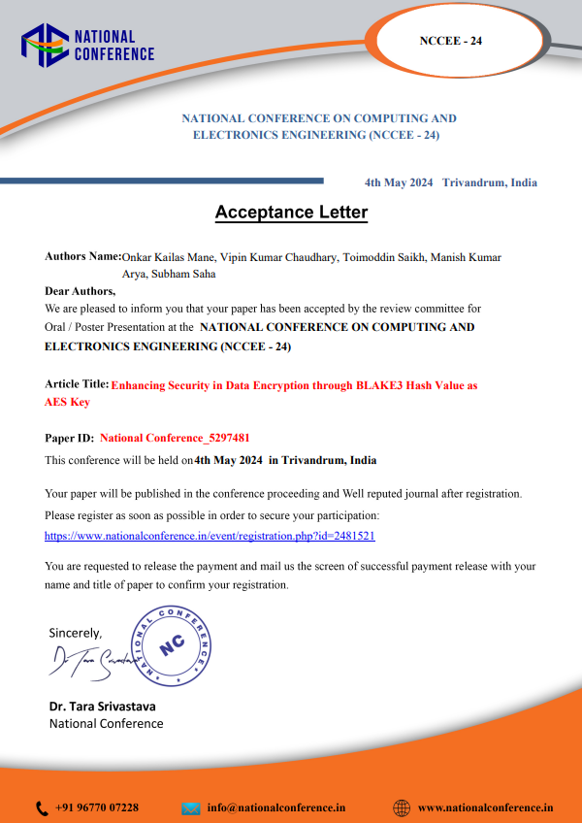
Publication Details
Research Proposal: Enhancing Security in Data Encryption through BLAKE3 Hash Value as AES Key
Paper ID: National Conference_5297481
Published By: NATIONAL CONFERENCE ON COMPUTING AND ELECTRONICS ENGINEERING (NCCEE - 24)
Status: Acceptance Approved

Slide 14
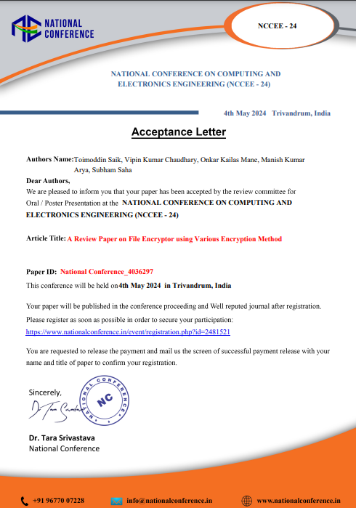
Publication Details
Review Paper: A Review Paper on File Encryptor using Various Encryption Method
Paper ID: National Conference_4036297
Published By: NATIONAL CONFERENCE ON COMPUTING AND ELECTRONICS ENGINEERING (NCCEE - 24)
Status: Acceptance Approved

Slide 15
Thank You !!!

